Slide 1
Chapter 12. Artificial deep neural network

Slide 2
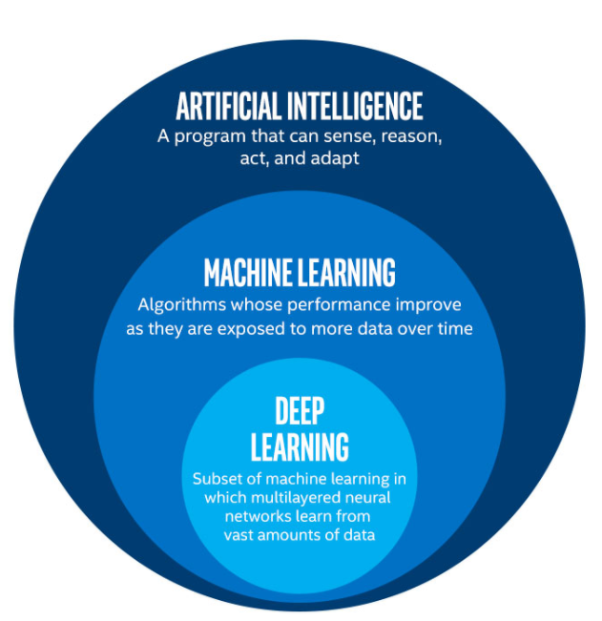
AI scope

Slide 3
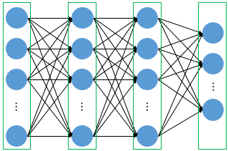
What is the artificial deep learning?
# of hidden layer: 2
Perceptron
Input
Output
Hidden layer

Slide 4
Review
Adaline
Gradient descent / Stochastic gradient descent
One hot encoding
Logistic regression

Slide 5
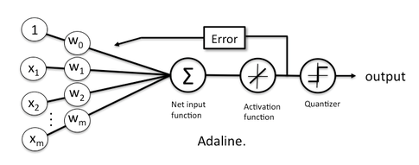
Review: Adaline

Slide 6


Review: Adaline
$$y$$
$$y=w^{T}x=w_{i}^{T}x_{j}$$

Slide 7


Review: Adaline
$$z$$
$$z=∅\left(y\right)=∅\left(w^{T}x\right)$$

Slide 8


Review: Adaline
$$z_{pred}↔z_{GT}$$
$$J(w) =\frac{1}{2}\sum_{i}{{\left(z_{pred}^{(i) }−z_{GT}^{(i)}\right)}^{2}}$$

Slide 9
Review: Adaline
$$z_{pred}↔z_{GT}$$
$$J(w) =\frac{1}{2}\sum_{i}{{\left(z_{pred}^{(i) }−z_{GT}^{(i)}\right)}^{2}}$$

Slide 10
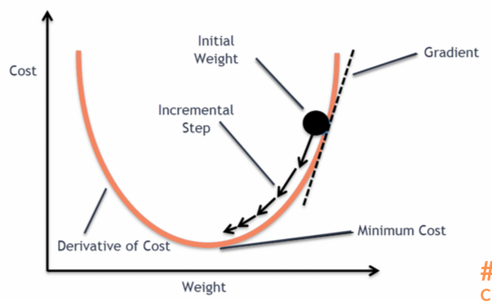

Review: Gradient descent
$$w=w+∆w$$
$$∆w=−η∇J\left(w\right)$$
Cost의 반대방향

Slide 11
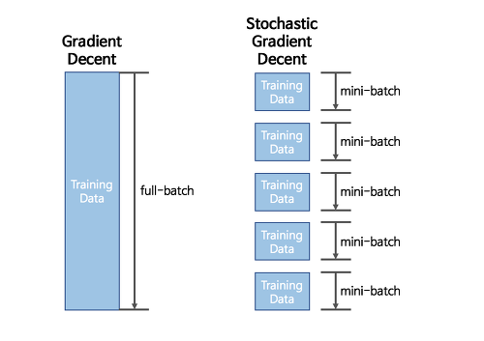
Review: Stochastic gradient descent

Slide 12
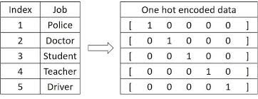
One hot encoding

Slide 13
Multi layer perceptron

Slide 14
Multi layer perceptron
Input
Output
Hidden layer

Slide 15
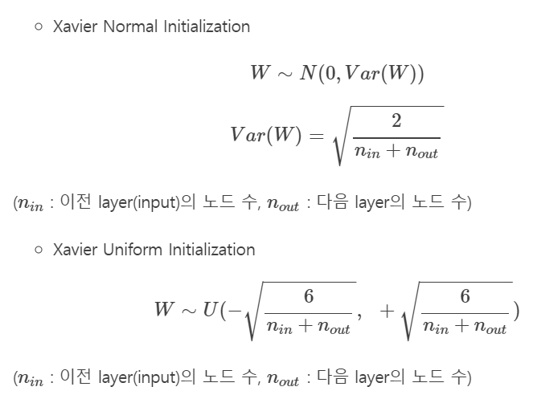
Multi layer perceptron: how to work?
Weight
Input
Layer 1
Layer 2
Output

Slide 16
Multi layer perceptron: how to work?
Forward propagation
Input
Layer 1
Layer 2
Output

Slide 17
Multi layer perceptron: how to work?
Input
Layer 1
Layer 2
Output
Loss calculation

Slide 18

Multi layer perceptron: how to work?
$$∆w=−η∇J\left(w\right)$$
Weight update
Input
Layer 1
Layer 2
Output

Slide 19
Multi layer perceptron: how to work?
Back propagation
Input
Layer 1
Layer 2
Output

Slide 20
Detail

Slide 21
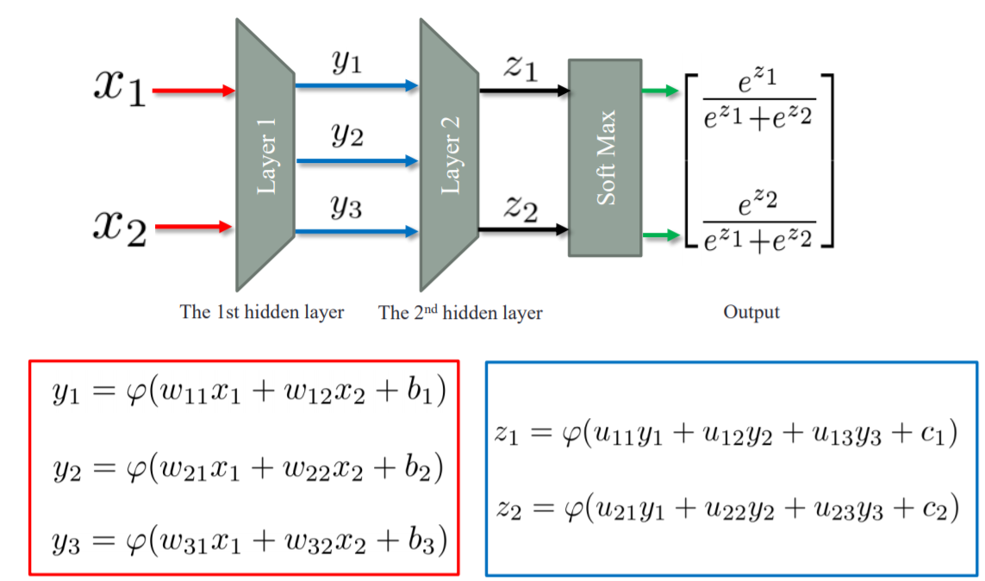
Forward propagation

Slide 22
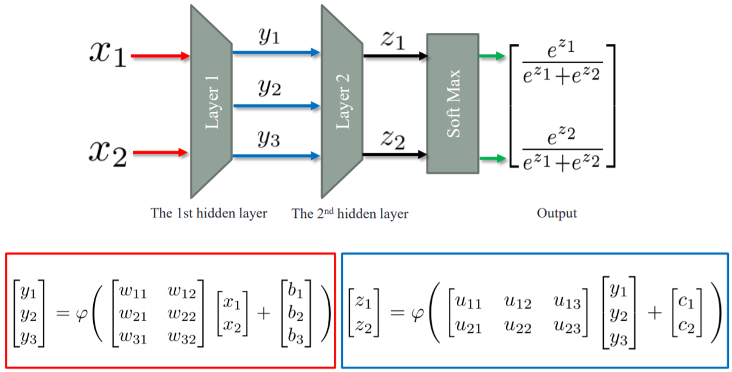
Forward propagation: matrix representation

Slide 23
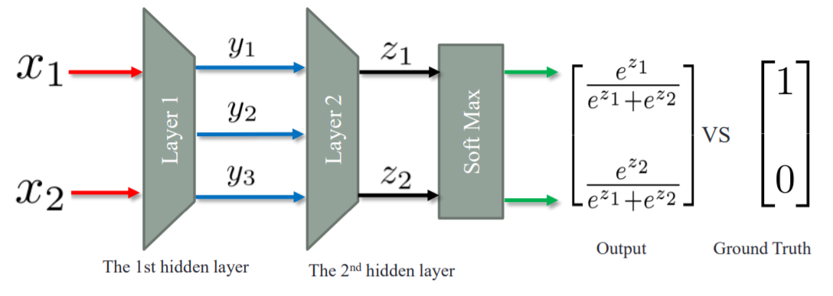
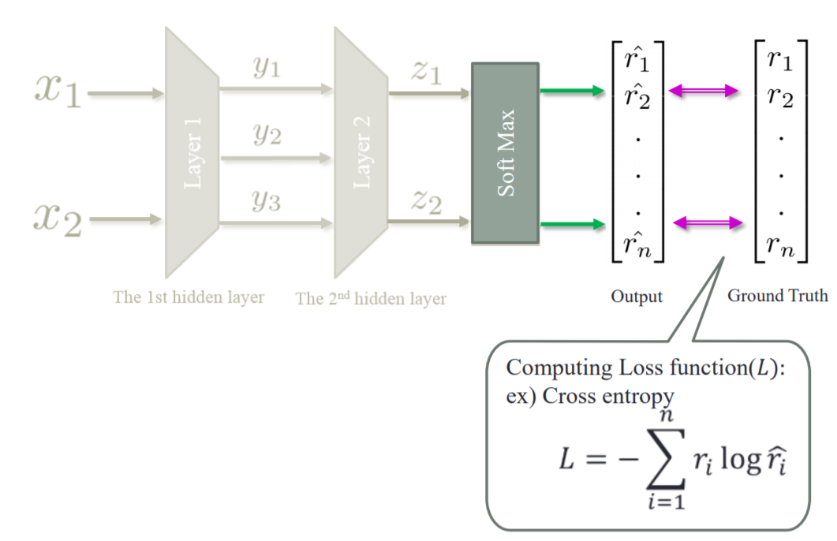
Loss calculate

Slide 24
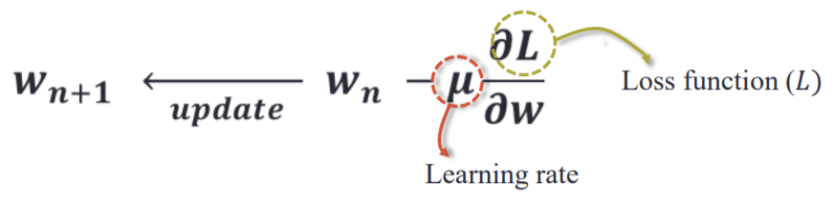
Weight update

Slide 25
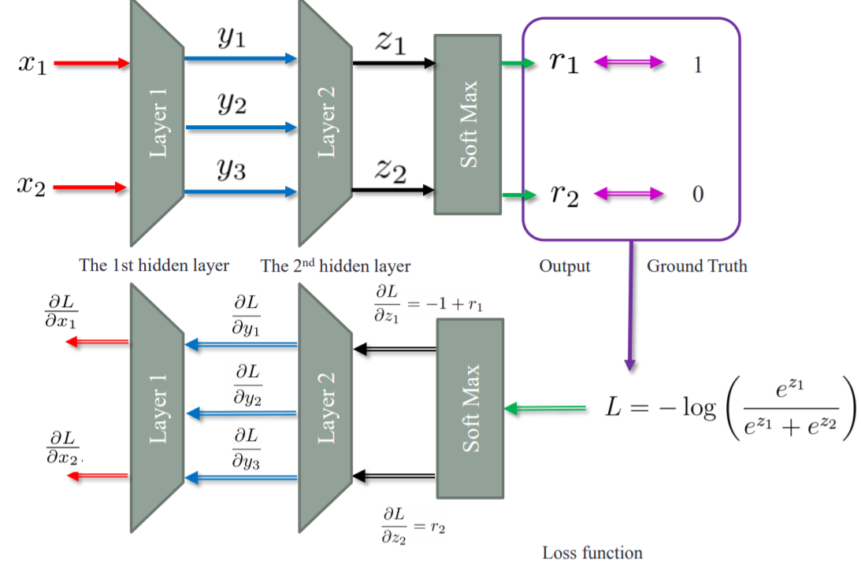
Back propagation

Slide 26
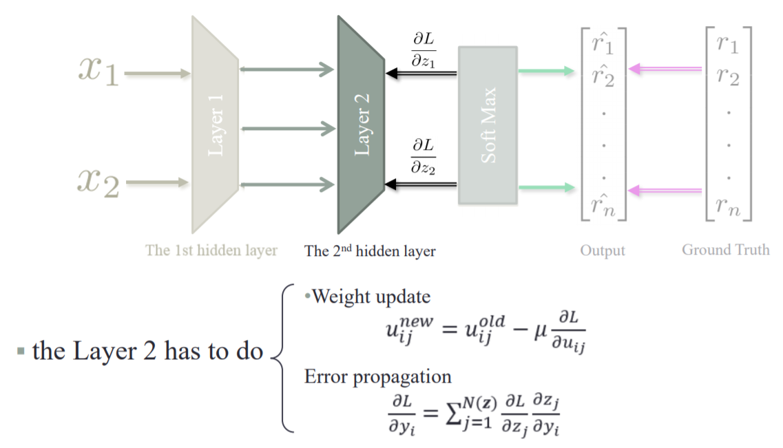
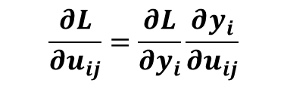
Back propagation
$$\frac{∂L}{∂u_{ij}}=\frac{∂L}{∂y_{i}}\frac{∂y_{i}}{∂u_{ij}}$$

Slide 27
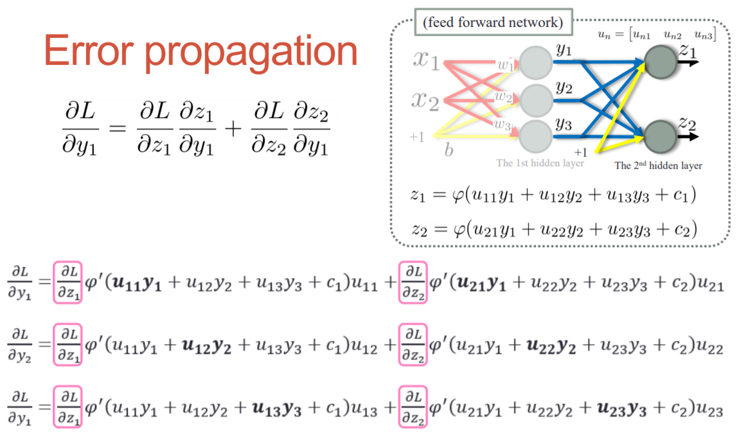
Error propagation

Slide 28
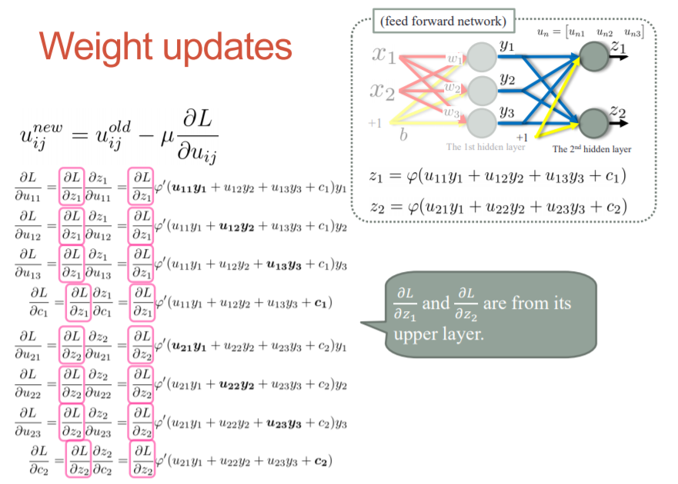
Weight update

